Slide 1
Quantifying Binaural Interaction

Slide 2
Cat – High frequency regions
64% Summation – binaural resp larger than resp to either ear alone
34% Suppression – binaural resp less than resp at dominant ear
Imig and Adrian 1977

Slide 3
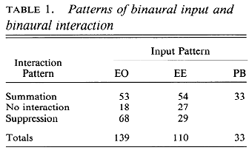
Cat A1
Little inhibitory responses using monaural stim
50% EO – excited by one ear, 88% by contralateral ear, little excitation from ipsi ear
39% EE – excited by both ears, 68% stronger in contra, low BF neurons have similar contra/ipsi excitation 16.5%, Ipsi stronger 15.5%
12% PB - weakly to monaural
Binaural interactions
Compare stronger monaural response with binaural resp
Summation - binaural stronger than either ear alone
Suppression - binaural weaker than the stronger monaural response
No interaction – similar binaural resp than stronger monaural response
Philips and Irvine 1993

Slide 4
Cat high frequency region
>90% influenced by ABL and ILD
>60% show nonmonotonic ABL or ILD selectivity (esp at best ILD), ‘dual nonmonotonic selectivity’
Semple and Kitzes 1993

Slide 5
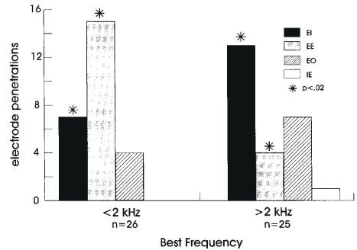
Awake macaques
Summation – 74% neurons below 2kHz
EE Binaural summation
EI Contralateral monaural dominance
IE Ipsilateral monaural dominance
EO No interaction
Classification based on Imig and Adrian 1977
Reser 2000

Slide 6
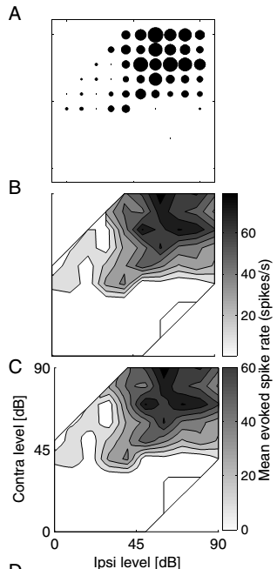
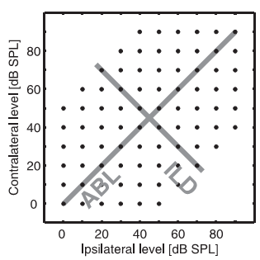
King – ILD and ABL
Ferret AC
Principle component analysis
Based on binaural function space
No evidence for discrete classes of binaural interactions
Highest slope in frontal space
Campbell et al. 2006

Slide 7
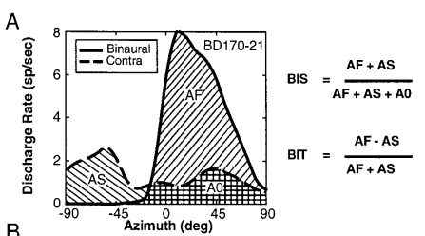
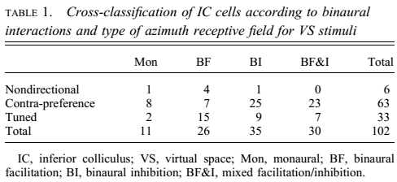
VAS – cats – IC neurons
BIS Binaural interaction strength
BIT binaural interaction type
AS
AF
A0
Delgutte 1999

Slide 8
Studies of Monaural and Binaural responses
Kuwada et al. 1984, Cat IC, 60% EE, 70% stronger response to contralateral, 65% monotonic (monaural), sum of monaural responses not equal to binaural resp since phase sensitivity has a role
Kuwada et al. 1997, Cat IC, Intracellular monaural and binaural responses
Subtractive – binaural resp less than contra resp

